Slide 1
Positive Psychology
Summary

Slide 2


Everyday Positivity
Positivity
Meaning, Purpose
Cultivate Attitude of Gratitude
Mindfulness Meditation
Altruism
Exercise
Eat Healthy
Cognitive Reframing
Learn a New Skill
Surround Yourself with
Loving, Kind People

Slide 3
Everyday Positivity
Positivity
Challenge your negative thoughts
Focus on your strengths and your successes
Start your day with a mindfulness meditation
See challenges rather than obstacles

Slide 4
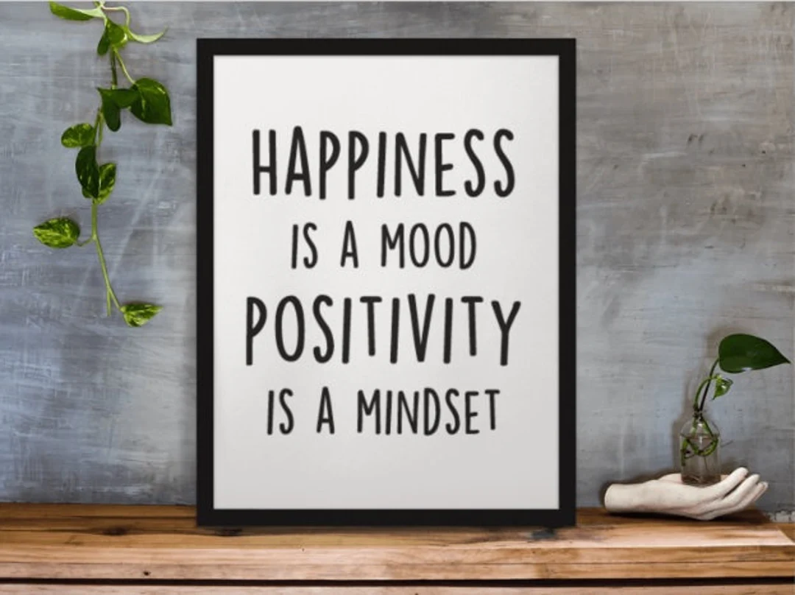
P
B2B market scenarios
Develop winning strategies to keep ahead of the competition
Capitalize on low-hanging fruit to identify a ballpark value
Visualize customer directed convergence
Cloud-based opportunities
Iterative approaches to corporate strategy
Establish a management framework from the inside

Slide 5
Ask yourself: Who can I make smile today?
“
”
Thich Nhat Hanh

Slide 6
Gratitude
Write a Gratitude Letter
Share a thank you card with a sweet treat
Keep a gratitude journal

Slide 7
Wonder and Awe

Slide 8

https://www.youtube.com/watch?v=vdlxk4RFCYM

Slide 9
Mindfulness
Mindfulness Meditation
Daily Mindfulness
Benefits
Bring mindfulness to everything that you do in your day
Improved sleep
Attention and concentration
Lowers stress and anxiety
Helps with depression
Impacts performance at work
Affects relationship quality
Insighttimer.com
Breath awareness, belly breathing, body scan, gatha meditation, loving-kindness meditation

Slide 10
Positive Emotions

Slide 11


Slide 12
Summary
Positive psychology is the scientific study of what makes people thrive. It focuses on behaviors that can lead to a more optimized frame of mind as well as on thought patterns that lead to more functional behaviors.

Slide 13

Thank you
Mirjam Nilsson​
mirjam@contoso.com
www.contoso.com

